Slide 1
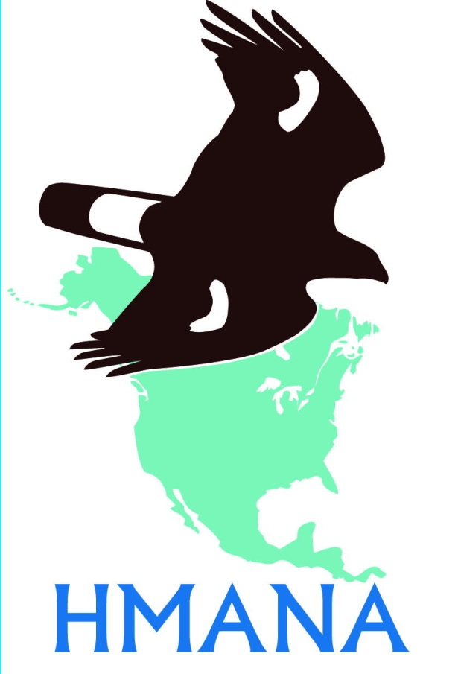
The Hawk Migration Association of
North America

Slide 2
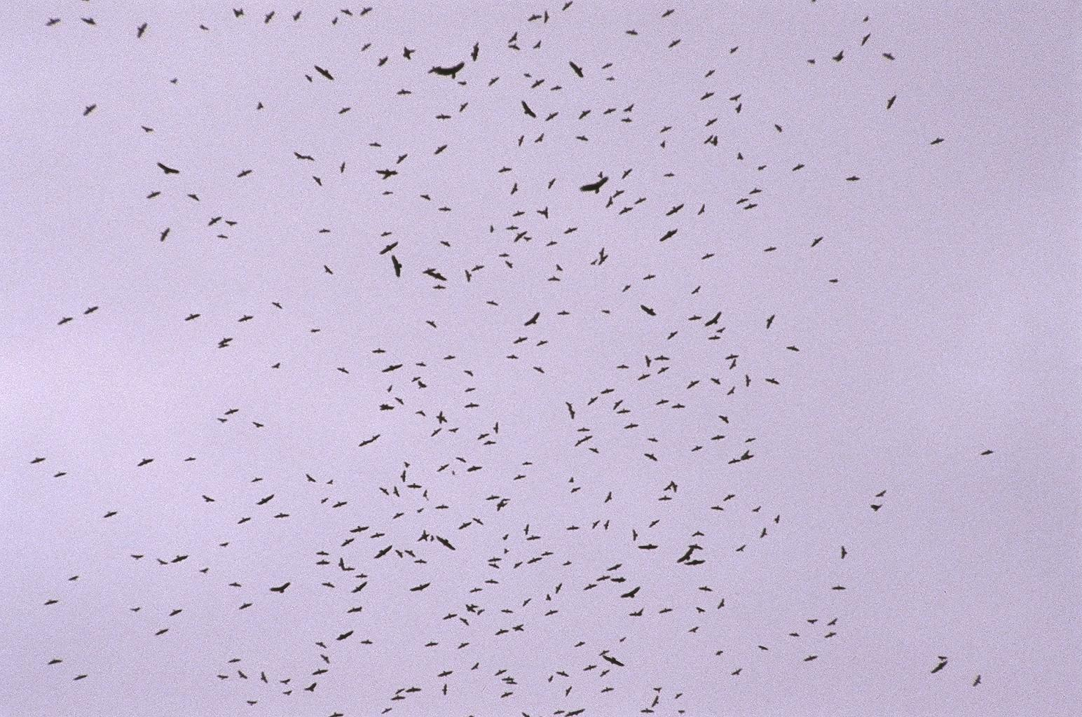
PRESENTS
IDENTIFICATION
of Raptors of the Northeast
For HMANA
©Susan Fogleman, producer
Copyright 2008

Slide 3
IDENTIFICATION
How can you know what you are seeing?
General impressions:
SHAPE
SIZE
BEHAVIOR
For HMANA
© Susan Fogleman, producer
Copyright 2008
Notes:
Most beginning hawkwatchers rely heavily on the standard field guides to bird identification. However, field marks such as color and wing markings are not always viewable on hawks passing a watchsite. This can be a result of many factors such as distance, bright sky, and backlighting.
In this program field marks will be referred to from time to time, but our main intent is to familiarize the viewer with the more “gestalt” aspects of raptor identification. The purpose of the field mark slides is to show any aspects of a bird that might be seen which would add a degree of confidence to an identification

Slide 4
Notes:
Pictured here is a mixed-species kettle photographed at Cardel, Veracruz, MX.
In addition to the circled hawk, a number of Turkey Vultures are evident.

Slide 5
SO…
NAME THAT HAWK!!!

Slide 6
It really is easier
than you might think…

Slide 7
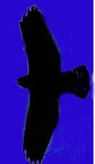
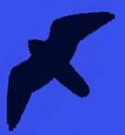
FIRST!
Learn the basic silhouettes/shapes of…
Accipiters
Buteos
Falcons
Eagles

Slide 8
Accipiters
are forest-dwelling hawks
Built for rapid flight and lightning quick turns in wooded habitats
Characterized by short, rounded wings and long, narrow tail
In migration or in open habitat they exhibit intermittent flapping and gliding flight

Slide 9
Accipiters typically fly
alternating
flapping
and gliding

Slide 10
“…flap
flap
flap,
gli-i-i-i-i-i-ide”

Slide 11
There are 3 species
of
North American
accipiters

Slide 12
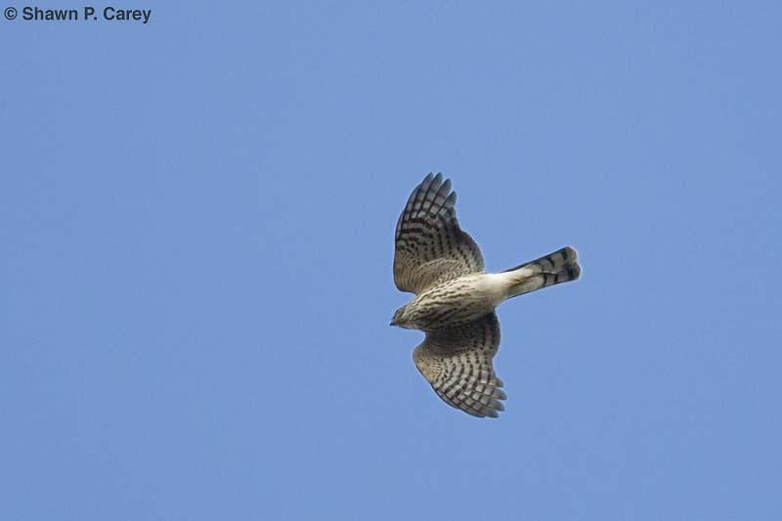
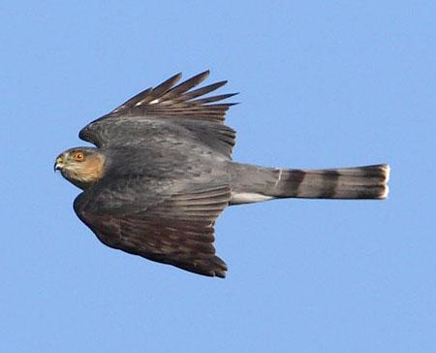
Sharp-shinned Hawk
the smallest accipiter
Blue Jay sized
Smallish head
doesn’t project beyond “wrists”
Short, rounded wings
Tail usually appears
squarish, sometimes
with a notch

Slide 13
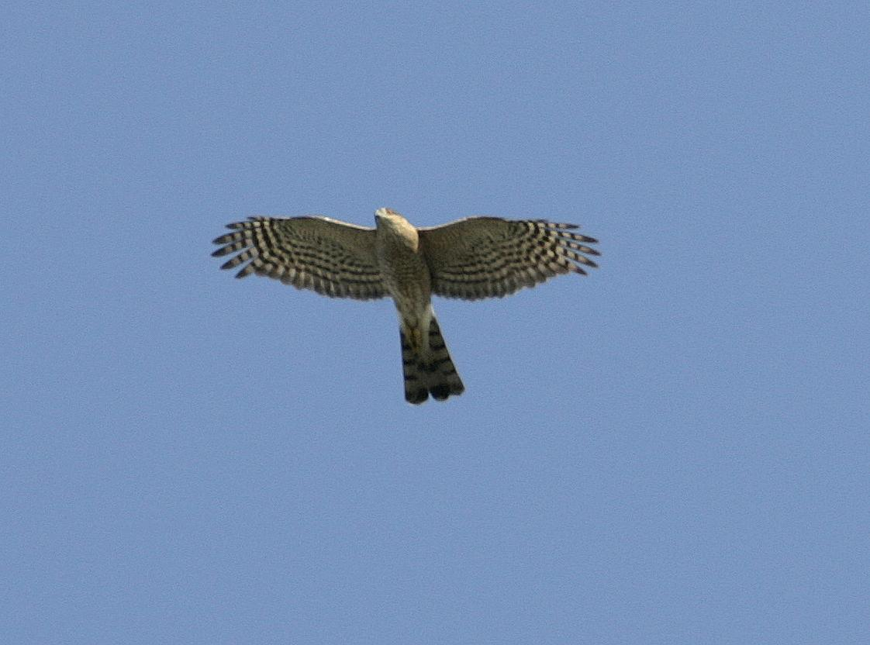
Wingbeat:
snappy,
deep,
rapid (hard to count)
“flippity flippity flippity … glide”

Slide 14
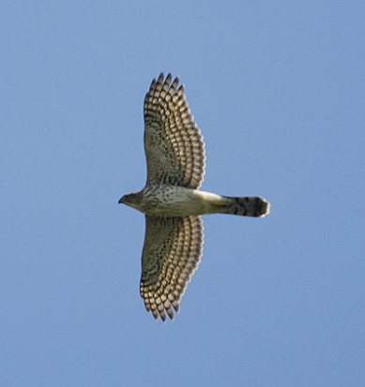
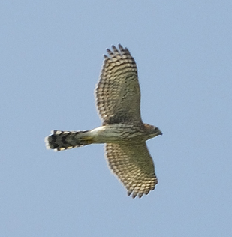
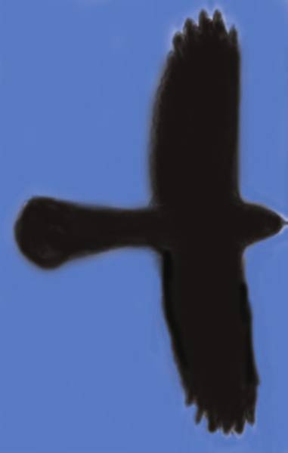
Cooper’s Hawk
medium-sized accipiter
Short-ish, rounded wings
Straight leading edge of wing
Protruding head
Long, usually rounded tail
Notes:
The Cooper’s Hawk pictured here is an immature. Adults have rust-colored barred underparts.

Slide 15
Wingbeat:
stiff,
shallow,
slower
“flappa
flappa
flappa …
glide”

Slide 16
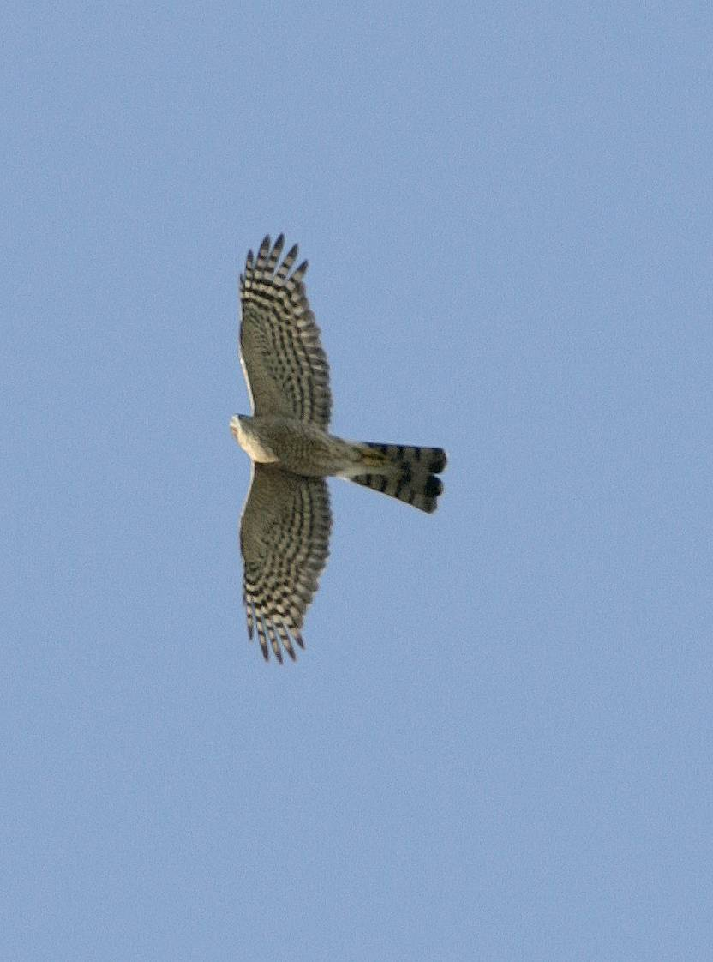
a longer-”feeling” appearance
than the Sharp-shinned
Sharp-shinned
Cooper’s
small head
protruding
head
squarish tail,
sometimes notched
Rounded
tail
a flying “T”
a flying cross
Notes:
Both of these birds are immatures.

Slide 17
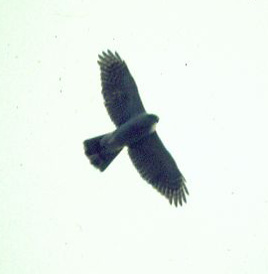
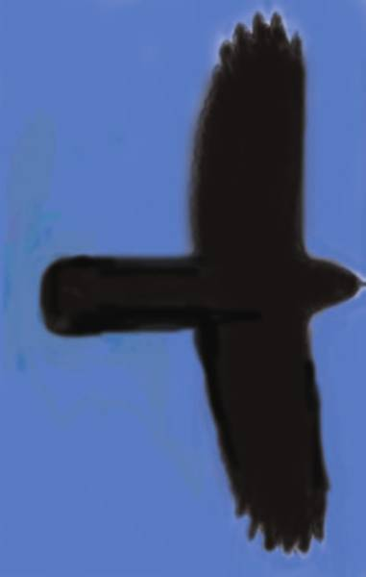
Northern Goshawk
largest accipiter
Short-ish (comparatively), rounded wings
Long, heavy-looking tail
“Chunky” cylindrical body
Deep, heavy wingbeat
Notes:
No clear pictures of adult Goshawks in flight could be found for this program. Many of the donors of photographs as well as other contacts said, “They’re on us before we know it, and then it’s too late to catch them!”
This is a testament to the fact that Goshawks can cover a lot of distance with each powerful flap of wings. As the late expert hawkwatcher Robert Smart once said, “Sharpies fly ‘flippy flippy flippy ---- glide. Coops fly ‘flappa flappa flappa ----gli-i-de.’ And Goshawks fly ‘FLOMpa FLOMpa FLOMpa gli-i-i-ide.’”

Slide 18
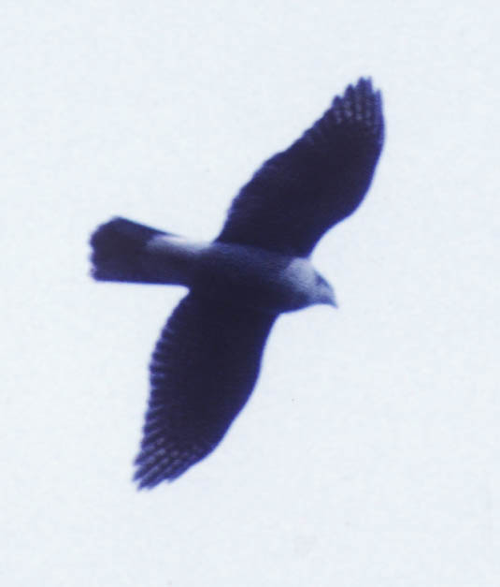
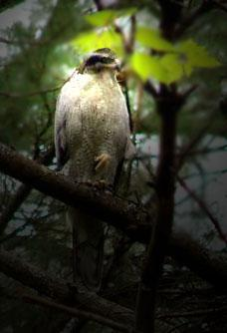
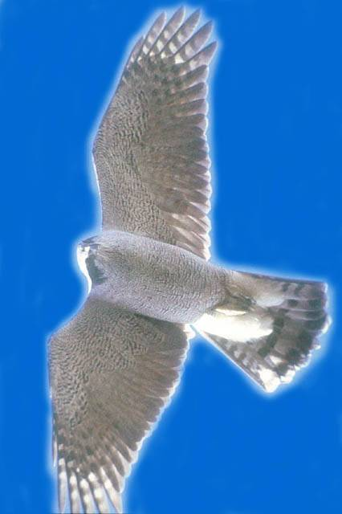
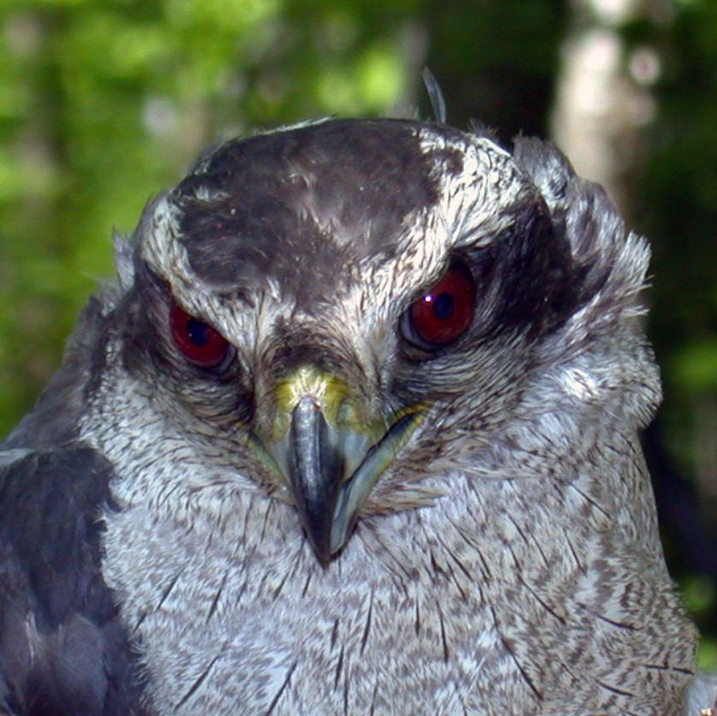
Sometimes the distinctive
dark eye-stripe and
white “eyebrow” (superciliary line)
can be seen
if the bird is close enough
Notes:
No field marks visible on this “blown-up” shot of an overhead Gos, and yes, that shot does look fuzzy. This is a good example of exactly how one might see this species in migration, and why knowledge/familiarity with shape and behavior is so important.

Slide 19
Buteos
are soaring hawks
Designed to use air currents
to minimize flapping
Generally found in more open areas
Characterized by long, wide wings and relatively short broad tail
Perfect form for using updrafts and thermals

Slide 20
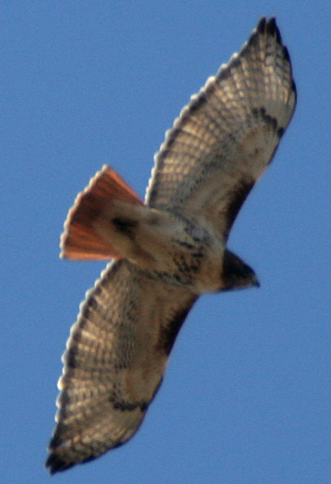
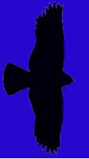
The quintessential Buteo:
Red-tailed Hawk

Slide 21
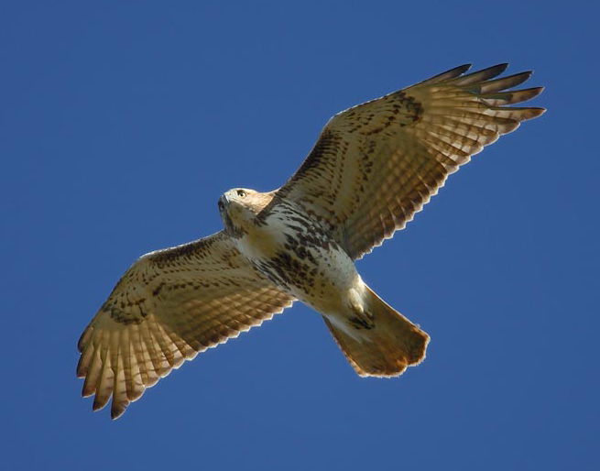
Red-tailed Hawk
“Comma”
“Squarish” wing tips
“Belly band”
Adults have
brick red tail;
juveniles’ tails
are faintly barred
and brown
Dark patagial area
Notes:
“Belly band” is noted in this slide, but it is important to know that belly bands on Red-tailed Hawks can vary from very dark and dense to only a few barely discernable speckles.
This sub-adult Red-tail shows some faint barring in the tail, which is beginning to show the rusty red of an adult. Younger Red-tails exhibit faintly barred brownish tails.

Slide 22
But
what if I can’t see those markings?????

Slide 23
Aha!!!
Remember those silhouettes?
And don’t forget behavior…

Slide 24
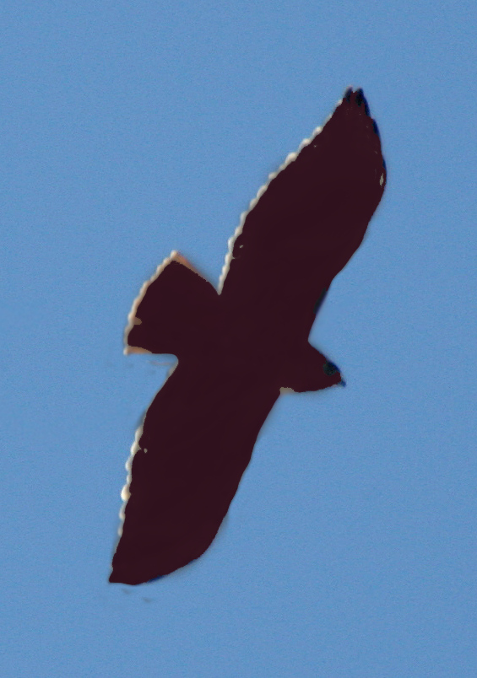
For example, notice on this
silhouette
Red-tail
“Bulging” secondaries
Relatively short tail

Slide 25
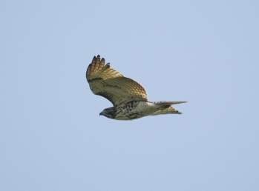
What do you notice about this bird?
It is soaring.
It is a buteo (as
opposed to an
Accipiter).
It seems to have bulging secondaries.
Hmmm, its wings seem to be in a slight dihedral (which means held above the horizontal).

Slide 26
This is what a dihedral looks like
when a hawk is coming toward you.
It is also what it looks like when a
hawk is going away from you!

Slide 27
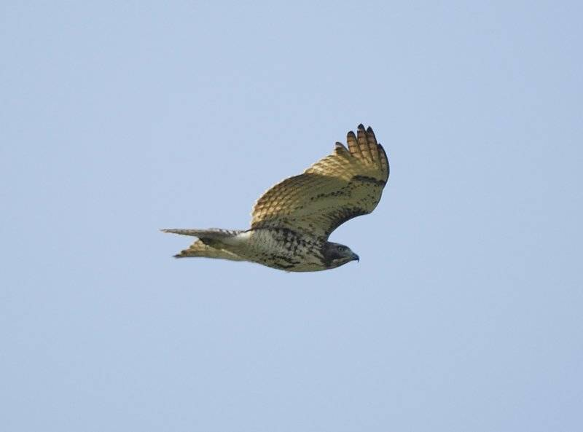
Red-tailed Hawks generally
soar with their wings held
in a slight dihedral

Slide 28
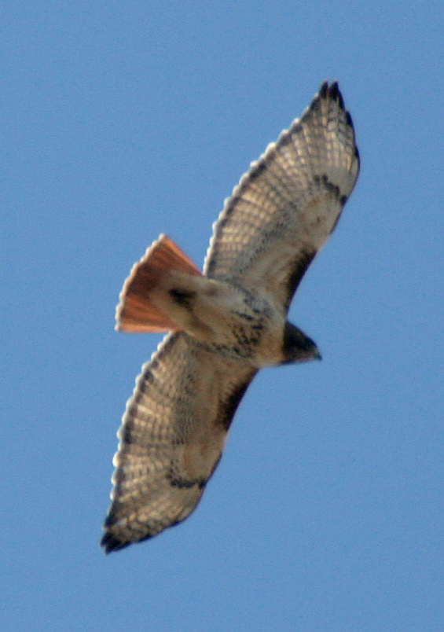
and Red-tails soar
“lazy circles in the sky”
in a calm and steady fashion
Notes:
Red-tails epitomize the hawk referred to in the song “Oklahoma!”

Slide 29
Top or bottom view
End view
Basic Red-tail flight profiles

Slide 30
And now…
more Buteos

Slide 31
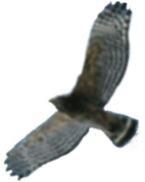
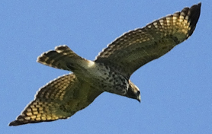
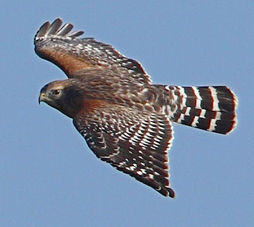
Red-shouldered Hawk
mid-sized Buteo
flaps wings a bit more
than other Buteos do
proportionately longer tail
wings reach forward
while soaring
white “crescents”
along tips of primaries
narrow white tail-bands
Notes:
Red-shouldered Hawks seem “hyper” compared to other Buteos. They can sometimes give an Accipiter-like impression because of this behavior and their longer tails. When a Red-shoulder is soaring in an updraft it does indeed flap more and makes frequent wing-adjustments.
The tail appears longer compared to Red-tails. This is because the Red-shoulder’s wings are narrower next to the body than are those of the Red-tail. Seasoned watchers refer to tail-length in terms of its relation to the depth of the wing
1
1.5

Slide 32
Top or bottom view
End view
Slightly bowed
Basic Red-shoulder flight profiles
Notes:
The end-view profile is shown as flat here, but Red-shoulders’ wings in a glide can also be slightly bowed.

Slide 33
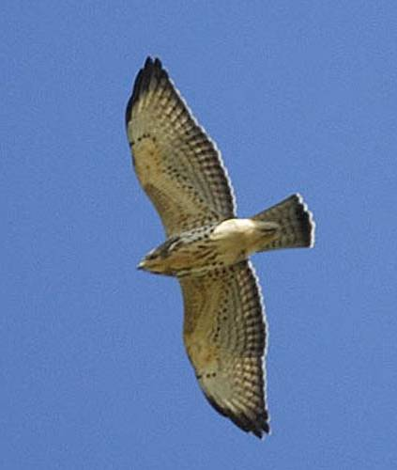
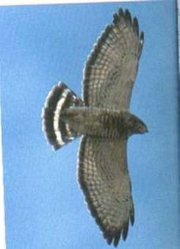
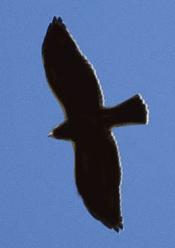
Broad-winged Hawk
chunky, crow-sized Buteo
“flame-shaped” wing
held straight out from body
wide white tail bands
pale under-wing with
black trailing edge
soaring flight

Slide 34
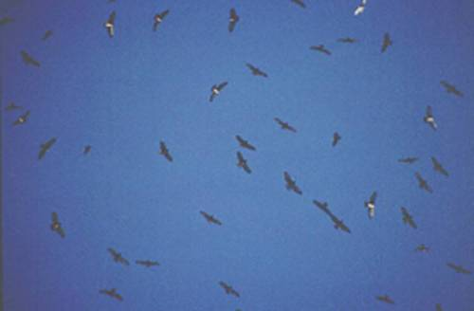
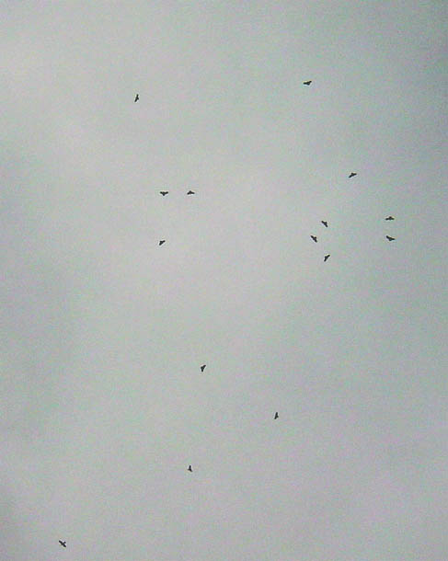
flocks (“kettles”) during migration

Slide 35
Top or bottom view
End view
Basic Broad-wing flight profiles

Slide 36
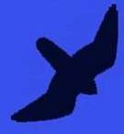
Falcons
are fast-moving raptors
Have a “sickle” shape
with
Long pointed wings
Long tail
Use powered, rowing flight
Rarely soar
(Peregrines and Kestrels sometimes do in migration)

Slide 37
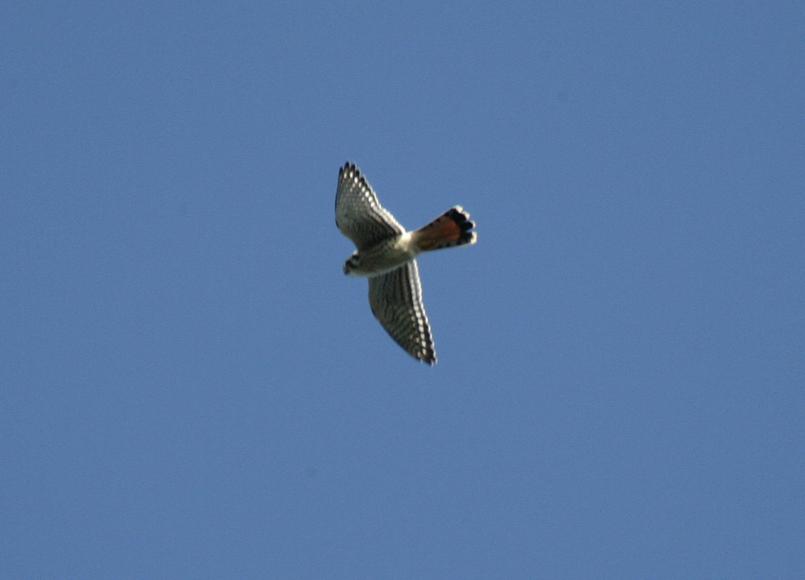
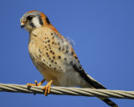
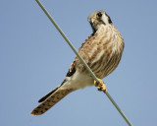
American Kestrel
our smallest falcon
males
and females
are dimorphic (differ in plumage)

Slide 38
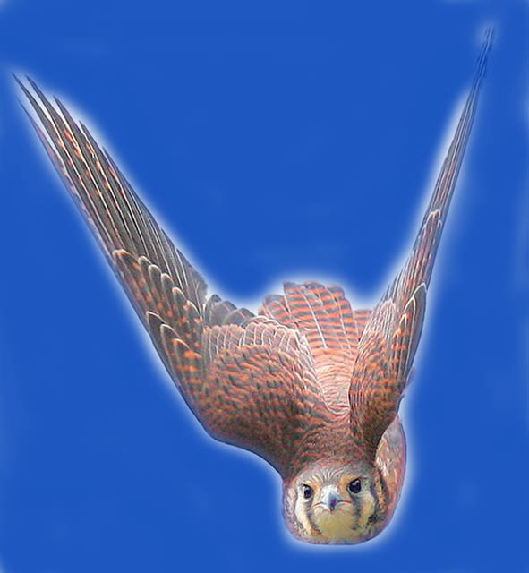
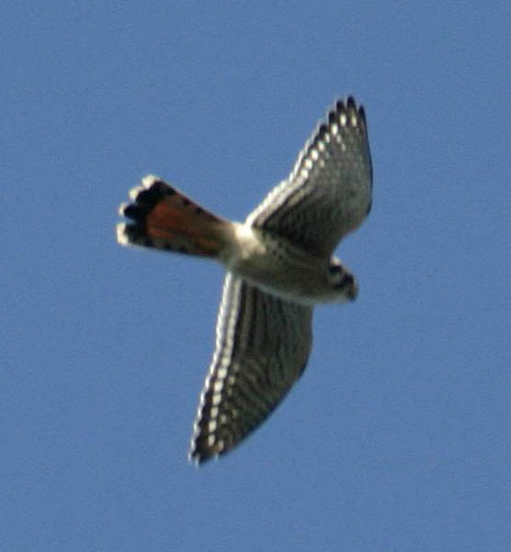
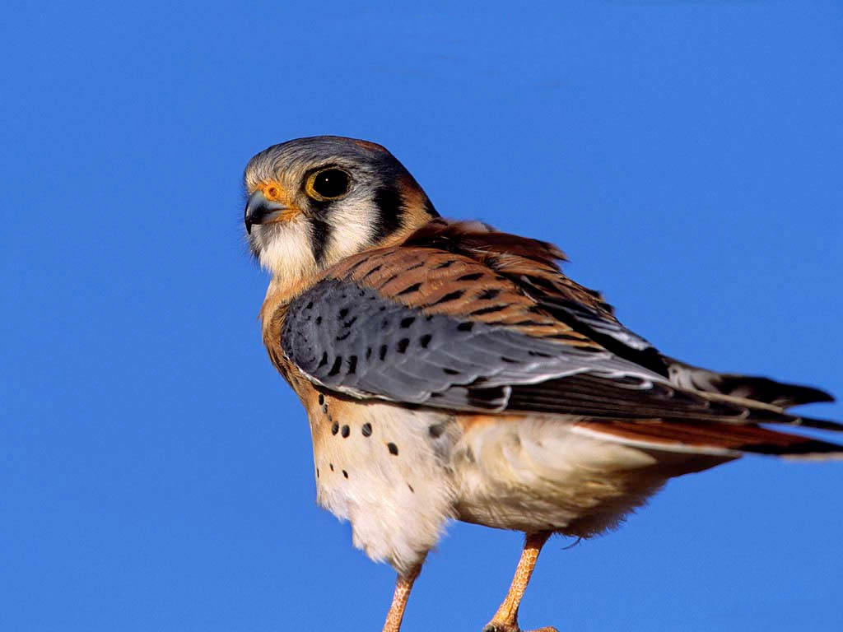
Female
has a more subtle rufous back
Male
has bright rufous
back and blueish wings
and numerous narrow bands in tail
with a single dark band
at end of tail

Slide 39
watch for white “dots” along trailing edge of wing in both genders

Slide 40
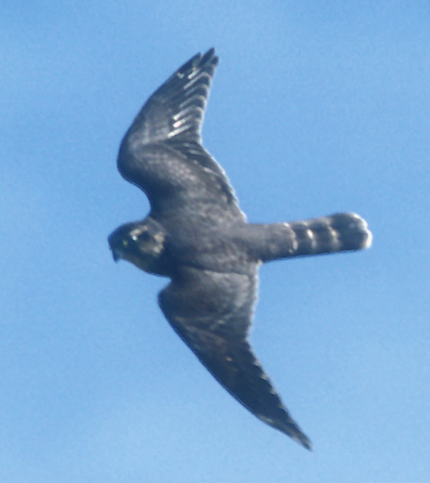
Merlin
just a little bigger than the Kestrel
a small, fast falcon
with powerful, flapping flight –shallower and faster than the Kestrel

Slide 41
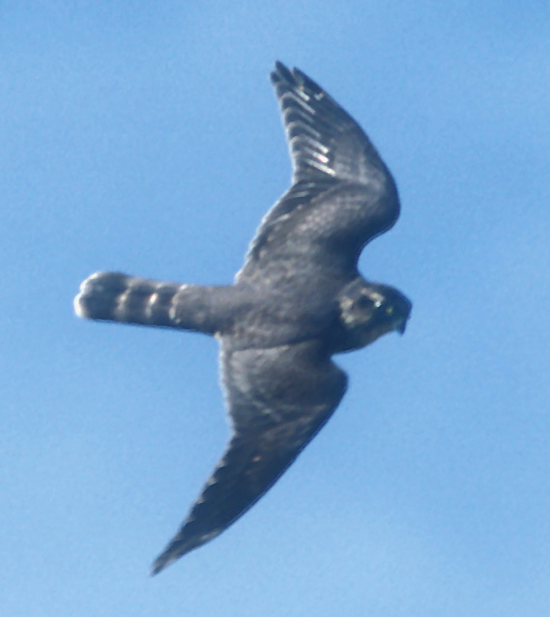
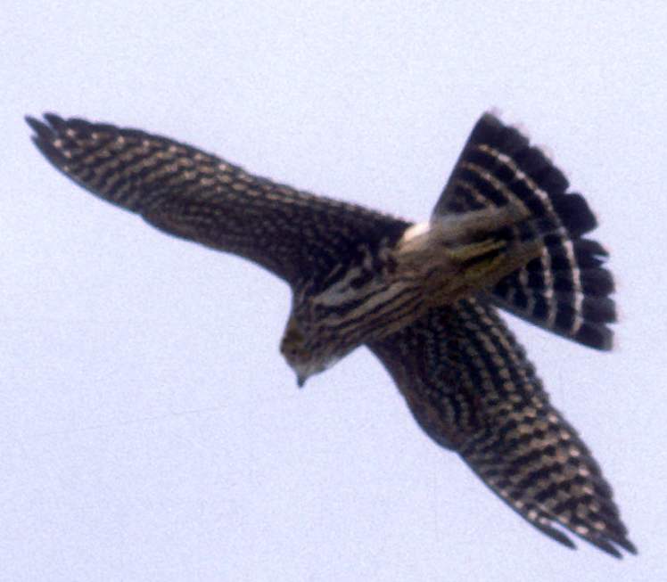
Wider wings than American Kestrel
Merlins have dark plumage
Like the Kestrel, they are dimorphic:
males are dark grey
females and young
are heavily streaked and chocolate brown

Slide 42
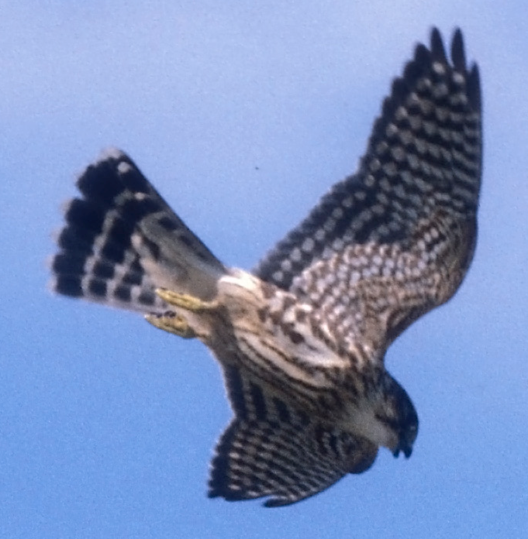
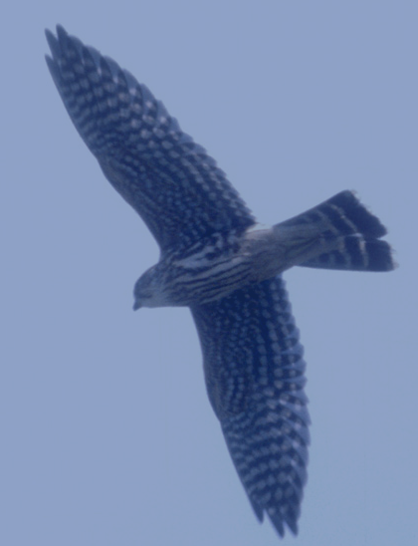
Merlins are often aggressive toward other birds in sky
….being harassed by Merlins
Red-tail…

Slide 43
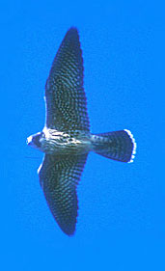
Peregrine Falcon
a larger falcon
Very long, pointed wings
Powerful, deep flaps – fast flight

Slide 44
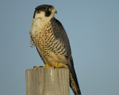
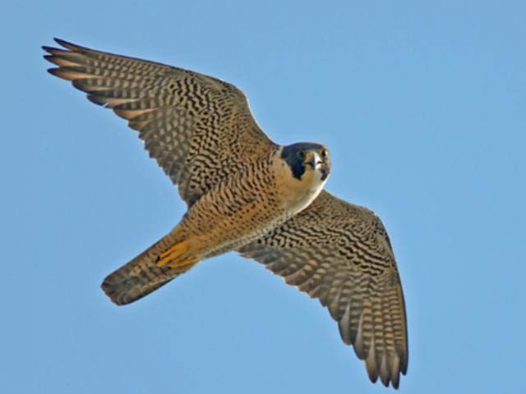
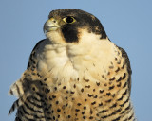
White upper breast
and throat
can usually be seen in flight
Dark cheek (moustachial) patch

Slide 45
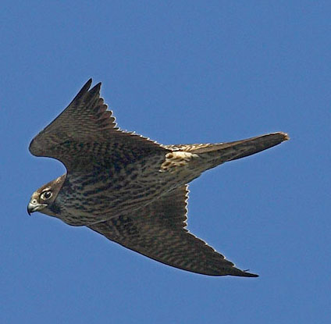
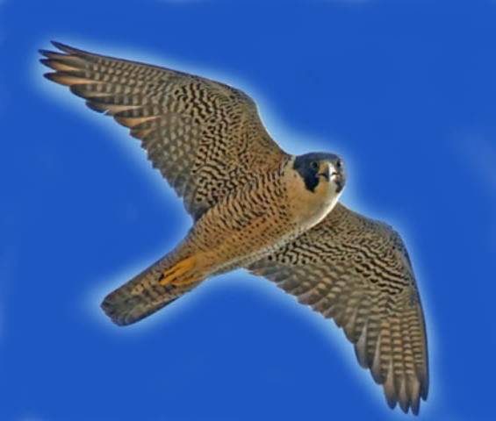
Adult has grey barring on breast
and dark heavy barring on underwing,
immature has
brown streaking

Slide 46
And now
some big birds…

Slide 47
Eagles
are very large soaring birds
6–7 foot wingspans

Slide 48
Bald Eagle

Slide 49
Large protruding head and bill
Long straight wings held flat when soaring

Slide 50
Immature Bald Eagles
are brown and can cause confusion with
other large brown birds
Plumages vary
It takes 5-years to reach adult plumage
White can be anywhere, mottled and blotchy
White in ‘wingpit’ area,
on belly and along line of wing

Slide 51
Remember!
Bald Eagle
Large protruding head and bill
…looks like a “flying plank”
Long straight wings

Slide 52
Golden Eagle
Large, dark soaring bird

Slide 53
smaller head than Bald Eagle
tail appears longer
“curvy” trailing
edge of wing
holds wings flat or
moderate dihedral
maintains a
steady flight

Slide 54
Golden Eagles
have “golden” feathers on the nape
Note slight dihedral:
wings held above the
body plane
Note longish tail
and relatively small head

Slide 55
White patches on Golden Eagles are restricted to base of tail and center of wing

Slide 56
Are you an eagle-eye?
QUIZ time!

Slide 57
Who’s who?

Slide 58
Which youngster is which?

Slide 59
Questions to ask yourself:
small head? large head?
blotchy white? white patches?
a “plank?” a dihedral?
Let’s look again

Slide 60
Bald Eagle
Golden Eagle

Slide 61
More big birds

Slide 62
Hey!
What kind of hawk is that????
It is a big bird, and it often soars.
But – note the head.
And the diamond shaped tail….
NOT a hawk, but often seen at watchsites
It’s a Raven!
Ravens are seldom alone; they flap more than hawks with a strong rowing wingbeat
Notes:
Soaring Ravens catch the eye of hawkwatchers time and again. Knowing their silhouette and behavior can save a lot of time trying to figure out “what kind of hawk” it might be. The sooner one realizes the bird in question is a Raven the sooner one can return to looking for actual raptors!

Slide 63
OK, back to raptors…

Slide 64
Osprey
a very distinctive shape
an
-shaped profile
White belly and head
Dark carpal (“wrist”)patches
Dark eye-line

Slide 65
Sometimes packs a lunch
and sometimes snacks while traveling

Slide 66
Females have “necklaces”
Ospreys always show a crook in the wing
This is a male
Notes:
There actually is some overlap in the amount of “necklace” streaking. However, birds with heavier streaking are usually females, and birds with none are males. (Clark and Wheeler, 2001)

Slide 67
And this is how you often see them
Going away it’s a

Slide 68
Northern Harrier
3-4 foot wingspan
long narrow wings
long tail
slender body
distinct dihedral
clear rectangular white rump patch

Slide 69
Females and young birds are brownish
Adult males are silvery:
grey above,
whitish below with black wingtips
Notes:
Female underparts are heavily streaked, whereas streaking on young birds is limited to upper breast and flanks.

Slide 70
Both genders display that
clear rectangular
white rump patch

Slide 71
A circus of
Harriers
Notes:
The scientific name for Northern Harrier is Circus cyanus.

Slide 72
Familiar dihedral fliers
Harrier
and…?

Slide 73
Presenting
the Vultures

Slide 74
Turkey Vulture
a very large bird
Floats through the air with wings in a pronounced dihedral
Often rocks from side to side

Slide 75
Turkey Vultures have contrasting colors on underside of wings
Flight feathers are silvery-grey from body out to the wingtips
Notes:
Flight feathers = primaries and secondaries

Slide 76
Black Vulture
has square-ish white patches at the wingtips
looks “stubby” due to wide wings and short tail

Slide 77
Let’s compare
Turkey Vulture
Black Vulture
Long wings
Pale flight feathers
Held in dihedral
Rocking flight
Longish tail
Broad wings
Ending in white patches
Flatter flight profile
Flaps more
Stubby appearance

Slide 78
Two to watch for:
another Buteo
and a Kite!

Slide 79
Swainson’s Hawk
Long-winged Buteo of the prairies
• dark bib,
sometimes split
• pale wing-pits
• dark flight feathers
wings held in dihedral
Notes:
Flight feathers = primaries and secondaries

Slide 80
Two birds with bi-tonal wings:
dark body, light flight feathers
Turkey Vulture
paler body,
dark flight feathers
Swainson’s Hawk

Slide 81
Mississippi Kite
a southerner edging northward
grey in color
very swift and graceful
floating flight
often seen catching
insects on the wing
falcon-like shape, but
narrower wings

Slide 82
Possible winter visitors
in wide open habitats
A Buteo
and
a Falcon

Slide 83
Rough-legged Hawk
a long-winged Buteo from the far north
has dark
and
light color morphs
light morphs show a
dark belly and
dark wrist (carpal) patch
broad white sub-terminal tail band
(all color phases)
exhibits a shallow dihedral when soaring

Slide 84
Gyrfalcon
the largest falcon
bird of the tundra
rare visitor south of the Canadian border
colors range from white
through dark grey

Slide 85
Remember this picture?
Remember the question?
Now imagine you are using your binoculars

Slide 86
What do you see?

Slide 87
If you said
“Broad-winged Hawk”
you were correct!

Slide 88
2
1
3
Final exam time!
4
5
6
7
8
9
10

Slide 89
The answers:
Red-shouldered Hawk
Black Vulture
Osprey
American Kestrel
Bald Eagle (immature)
Peregrine Falcon
Sharp-shinned Hawk
Red-tailed Hawk
Cooper’s Hawk
Broad-winged Hawk

Slide 90
Caveats
Now that you know all the answers and feel ready to get to your local hawk watch and ID everything that flies overhead
keep the following in mind:
Birds change shape, depending upon winds, light, the angle of view

Slide 91
A falcon in a glide may spread its tail to soar on a thermal

Slide 92
A buteo straight overhead make look very different when seen at an angle

Slide 93
A Few Final Points
Nobody is right 100% of the time
For every rule, there is an exception
(Ex.: a Sharp-shinned hawk with a rounded tail)
Every bird teaches something –
once you’ve ID’d it, stay with it, see how it moves, changes shape, how it looks at different angles
Take time to enjoy the beauty of raptors

Slide 94
Tools for Hawk Identification
Hawk Field Guides:
Clark, W. and B. Wheeler. Hawks. Peterson series.
Dunne, P., D. Sibley, C. Sutton. Hawks in Flight. Houghton Mifflin Co.
Liguori, J. Hawks from Every Angle. Princeton Univ. Press
Wheeler, B. Raptors of Eastern N.A. Princeton Univ. Press.
Wheeler, B.K. and W. Clark. A photographic guide to N.A. Raptors. Academic Press.
Video: Hawk Watch, a video guide to Eastern
Raptors. R.K Walton & G. Dodge

Slide 95
All photographs are protected by copyright law and permission for use outside of this program is prohibited without permission of the photographer or provider.
Photos from:
Vic Berardi
Shawn Carey
Kate Davis
Ken Dudzik, USFS
Susan Fogleman
Wavell Fogleman
Angel Karedes, USFS
Joseph Kennedy
David McNicholas
Rob Palmer

Slide 96
Special thanks to
Paul Carrier for the silhouettes
from the brochure A Guide for Hawks Seen in the Northeast ©
Thanks to the following for contributions of photography, photo-searching and for invaluable suggestions:
Vic Berardi
Shawn Carey
Wayne Greenstone
Carolyn Hoffman
Steve Hoffman
Joseph Kennedy
Lisa Lundari
David McNicholas
Wavell Fogleman
Gil Randell
Paul Roberts
©Robinlea Productions
Kim VanFleet
Joyce Weston
Mariko Yamasaki

Slide 97
This program is a HMANA production
in partnership with Robinlea Productions, Susan Fogleman producer/designer
Copyright 2008 all rights reserved
Copying, altering, or using any portions of this program without expressed permission of the photographer or provider is strictly prohibited.

Slide 98
Copyright 2008 all rights reserved

